Slide 1
Software Requirements
CSCE 247 - Lecture 2 - 01/16/2019

Slide 2
Today’s Goals
What are requirements?
Understand the requirements problem
Why are requirements so important?
Get a feel for the structure of a requirements document
What goes in there?
Start to learn how to write “good” requirements
Clear and testable
Notes:
We have covered the basic principles of software engineering and how to organize teams and the process. This week, we’ll step into the first of the major development phases - the requirements specification.

Slide 3
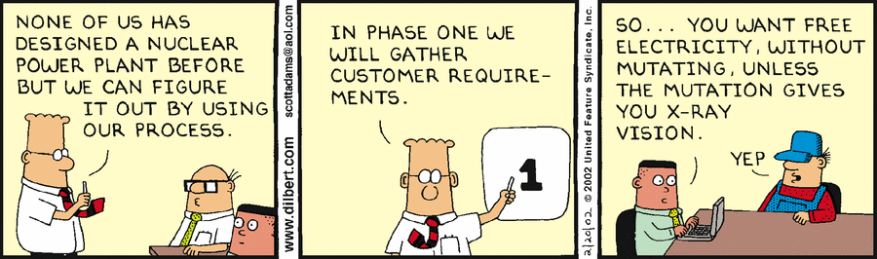
Software Requirements
Notes:
The requirements specification phase is really where we kick things off. Before we can code the software, before we can design the class structure, we need to decide what the heck the software is going to do. What features does it need? What should the resulting output be? What defines correct software behavior? The requirements define our goals for the software, what we promise the final product will do.

Slide 4
What is a requirement?
A requirement is a singular documented physical or functional need that a particular product must be able to perform.
“The software shall be able to calculate the sum of a column of integers.”
A statement that identifies a necessary attribute, capability, characteristic, or quality of a system for it to have value and utility to a stakeholder.
Notes:
Here’s a clear definition.
(read)
Essentially, the requirements for a system are a set of promises - here is what the system will do, here are the constraints it will follow, here are properties that must be met to release the product and consider it finished.

Slide 5
Some Requirements...
From an infusion pump:
The application shall allow the Clinician to configure Patient information, Drug Information and Infusion parameters for basal, patient bolus and square bolus Infusion.
The application shall allow the Clinician to enter new patient data only when the infusion pump is in Off or Paused State.
The application shall perform all Patient and drug data validations after the Clinician enters the values.
The application shall request clinician confirmation of the the patient and drug information before initiating infusion
If Infusion is in progress during the configuration, the system shall continue infusion with existing parameters, until the new configuration is confirmed by the Clinician
Notes:
To give you an example, here is a set of five related requirements for the software of an infusion pump, a device used in hospitals to administer drugs to a patient. (go over)
The remaining four are separate requirements, but are all related to making the first one possible and filling in details on what is meant in that first one (go over more)
Make sense?

Slide 6
Requirement Specification
A requirement’s specification is a comprehensive technical description of how that requirement will be realized.
The set of specifications will fully describe what the software will do and how it will be expected to perform.
Notes:
A requirement is a high-level statement of something the software must do. A property that must be met. Most requirements, then, are accompanied by what is called a specification - (1). Not requirements in themselves, but the details needed to successfully meet that requirement.
The terms requirement and specifications are often thrown around interchangeably, because they are often delivered in the same document, but keep that difference in mind. The requirement is what you are promising, and its accompanying specification is the explanation that makes it possible to implement. Anybody can understand the high-level requirements - those are a checklist of things that your software will offer, but specification is something the engineers need to actually realize those promises - the detailed definition of what the software needs to do, what conditions it will do it under, what the input should look like, and what will come out when you’re done.(read 2)

Slide 7
Specification Example
Requirement:
The user shall set a password to control account access.
Specification:
The password shall be at least eight and no more than sixteen symbols long.
The password shall contain at least one lower case and one upper case letter.
The password shall be hashed and stored in the password database (Req 3.4).
Notes:
To give an example of the level of detail that you should expect. First, we have the requirement, (read)
This is sufficient for a high-level purpose, you know that users must create passwords . There is probably another requirement stating that they have a user name too. This isn’t enough to implement the function, to know the constraints that good behavior must follow. That leads into the specification, which defines corrent password setting behavior. (read)
These would go on a bit longer too. You need enough detail to completely and clearly specify the rules this password must follow and how the system handles this functionality. This can refer to other requirements too for additional details, Req 3.4 in this case, would deal with password storage. Why not go into storage details here? (discuss) Requirements - one thing at a time. One clearly defiined property per requirement, don’t combine them in one.

Slide 8
Specifying Requirements
Requirements and their specifications are a description of what the system should do.
They capture what the system is doing, not how it does it.
How = how the code is structured, what algorithms and data structures are used, etc.
(that is the design).
Must be detailed enough to distinguish between the “right” and “wrong” system.
Notes:
(read)
(read) They don’t capture design details - they don’t specify exactly how you should code something, what the system classes and method are and how they work together, but they define what we will eventually implement - what the functionality should be - what acceptable behavior is, what output looks like…
But, high-level doesn’t mean low-detail, (read) So, they not only have to make it clear what correct behavior is, but it should also be clear what differentiates it from bad behavior, when we go to code this, there should be no ambiguity in what the right behavior is that we expect. The requirements form the basis on which we can judge the final product.

Slide 9

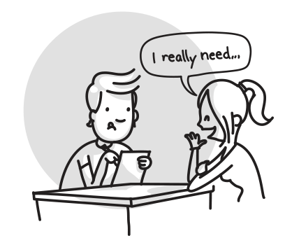
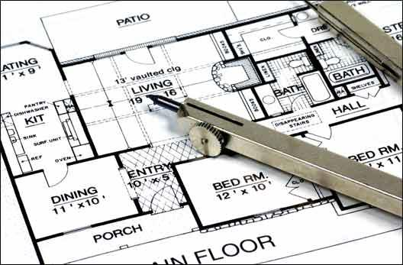
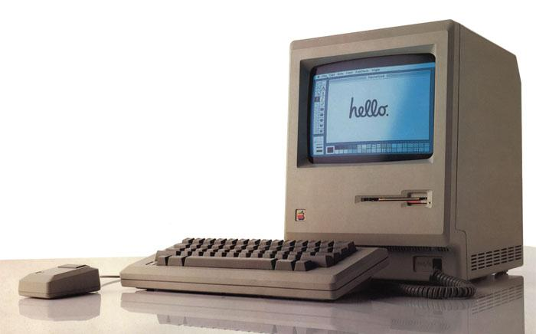
The Importance of Good Requirements
Concept Formation
Most of the problems sneak in here!
Requirements Specification
Implementation
and Testing
Design
Notes:
It is important to get your requirements right, that your requirements and their specifications be clear, detailed, and verifiable, because that is where most of the problems pop up.
You’d think that the majority of problems that appear in a project would be from bugs in the code, but that isn’t actually true. The majority of problems that strike software projects are conceptual - problems from incomplete, ambiguous, or non-existant requirements.
If you want to produce robust software, than you need to work on producing good requirements.

Slide 10
Importance of Requirements
“The single hardest part of building a software system is deciding precisely what to build… No other part of the work so cripples the resulting system if it is done wrong. No other part is more difficult to rectify later.”
Fred Brooks
Notes:
in other words (read)

Slide 11
In other words:
“The spec was vague”
Notes:
(title) - technically, both of these do what they were supposed to.. In a way - a spinning motor-powered device on the ceiling, encourage people to have clean hands when calling for an elevator. Neither works as you might hope. The requirements control the final product. If the specifications, the requirements are vague, incomplete, you lose control over the product and likely won’t get what you were hoping for.

Slide 12
The Stakeholders
The specification process must involve all stakeholders:
Clients
Engineers
Regulatory Agencies
Users
Do all of these want the same thing?
Notes:
One of your biggest problems - one of the major sources of this issues - is that there are a number of people involved in the creation of software, and they all have their own views on what this product should end up being. You need to please all people. In defining your requirements, you need to consider everybody who holds a stake in the outcome:
clients, whoever is paying you to produce the software - you need to meet their goals and satisfy their desires
engineers - they need to build the system, the requirements need to be there for them to use
regulatory agencies - if you’re building software that needs to follow certain laws and regulations, then the appropriate regulatory bodies need to be satisfied, the requirements need to be shown to meet their constraints
and the end users - they need to be considered, the system needs to fit their needs as well
You need to know who your stakeholders are - who would be interested in your project, who can place constraints on what you’re building? you need to define these, and you need to know what they want. Do they want the same thing? No - they don’t. You need to express the requirements in a way that they can all understand, and that meets all of their needs in an acceptable manner. This is a huge task.

Slide 13
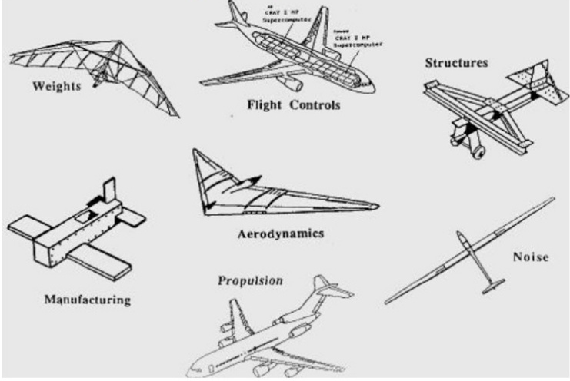
The Stakeholders
One requirement can have many meanings depending on the stakeholder’s perspective.
Notes:
No - they don’t, and worse - they may all interpret the requirements differently. One thing may mean something else to them. It’s not just dependent on their technical background either - if anything, that makes it worse. Show requirements for a plane to two engineers, and one might think about it from the perspective of aerodynamics, an other from the perspective of manufacturing.
You need to express the requirements in a way that they can all understand, that captures a comprehensive point of view. You need to understand what they’re looking for too, and you need to try to please these groups with different interests. This is a huge task.

Slide 14
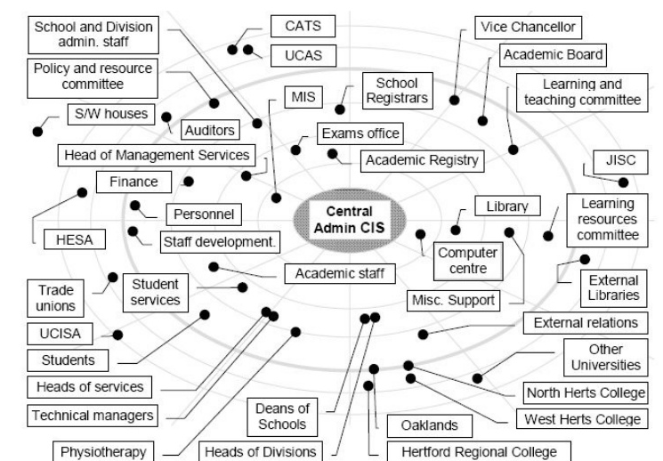
There Can Be Many Stakeholders
Notes:
Especially since the number of stakeholders can be insane. Consider something like Dropbox, which is powered by asoftware platform called Moodle. In some sense, almost every person in the university structure will be impacted by that, and most of them will have some say in how a system like that is designed and implemented. That can get tough as a developer, and this is another of those trade-offs. Who do you make happy and who do you ignore? How do you express the requirements clearly to them so that they’re happy when they get the final system?

Slide 15
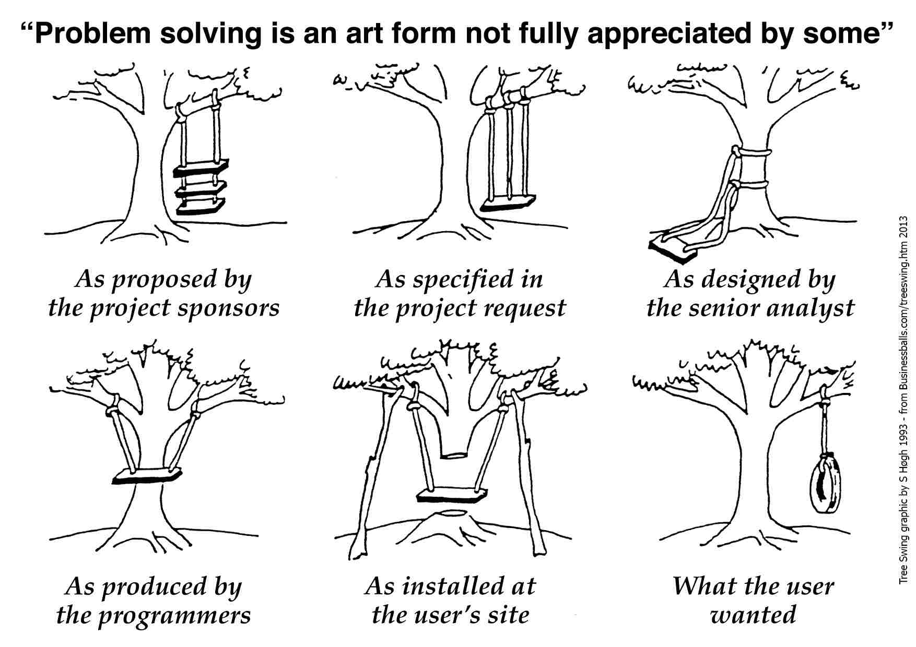
Importance of Requirements
Notes:
And you want to be careful to avoid ambiguity in your requirements, because that does not just affect the requirements, but the entire project to come. Vague requirements, incomplete requirements, can be followed and met - you’ll just get into a situation like this. (go over)

Slide 16
Importance of Requirements
The Engineering Argument:
Engineering is about developing solutions to problems. A good solution can only be developed if engineers understand the problem.
The Economic Argument:
Errors cost more to correct the longer they go undetected.
The Empirical Argument:
Failure to understand and manage requirements is the biggest single cause of cost and schedule over-runs
Notes:
The importance of requirements can be argued from three different perspectives: engineering, economic, and empirical
read
read, the cost of correcting requirements errors during the maintenance phase is at least 100times what it would cost in the requirements phase.
read

Slide 17
Key Points
Requirements capture what a proposed system should do, and the constraints they should follow.
Poor requirements are the source of all evil.
Requirements problems are the:
Most costly
Most difficult to correct
Notes:
Requirements and their specifications capture (read)
Poor requirements are the source of all evil - they will bring down your project.They are the most expensive and most difficult to fix because they are conceptual - if you build your project from a poor conceptual base, you are going to have a hard time fixing it.

Slide 18
Types of Requirements
Notes:
So, that’s what requirements are and why they’re important. Let’s talk some about writing the things.

Slide 19
Types of Requirements
User Requirements
Properties that the user wants to see out of the final system.
Typically reflect what the user wants the software to make possible in the real world.
“The user shall be able to book a concert ticket through the system.”
Usually high-level and lacking in technical detail.
Gathered from the user, and form the basis for technical requirements.
Notes:
Typically, there are several types of requirements that you might see in a project. (1-2, example).
(4) - these aren’t something you use to go and start writing code, rather (5) gathered at the start of the project. They let you put together a skeleton document and have something to start fleshing out.

Slide 20
Types of Requirements
Hardware Requirements
Define the properties expected from and constraints on the physical hardware in a system.
Expectations on storage space, CPU, network latency, sensor inaccuracy bounds, etc.
Example (from a pacemaker):
The Device Control Monitor shall either:
use an inductive telemetry wand to communicate with the pulse generator, maintaining consistent communication over the range of 0 cm to 5 cm between the wand and the pulse generator; or,
use some other medium, such as RF or ultrasound, that is safe and legal to use, for maintaining consistent telemetry with an implanted medical device.
Notes:
(1-2), whether dealing with a embedded system like a robot or car, or just the machine or server the software is instaled on. These requirements typically deal with things like (3). Go over

Slide 21
Types of Requirements
Software Requirements
Properties of and constraints on the software being executed on the system.
Bulk of requirements, typically.
Example (from a pacemaker):
If dynamic, the AV delay shall be determined individually for each new cardiac cycle based on the duration of previous cardiac cycles.
The previous cardiac cycle length is multiplied by a factor stored in device memory to create the dynamic AV delay.
The AV delay shall vary between a programmable maximum paced AV delay and a programmable minimum paced AV delay
Notes:
It follows then, that, (2-4). Go over

Slide 22
Types of Requirements
System Requirements
Define how software and hardware must work together to perform functionality.
Often related to interfaces, input, or output - how hardware can influence the software.
Example:
An automatic pacing threshold test shall be available on command of the DCM for both pulse width and amplitude measurements.
The user is instructed to terminate the test by removing the telemetry wand or selecting the ”Stop” button when loss of capture is observed.
The last six test results will be displayed on the screen and printed report.
Notes:
Then, (1), deal with the combination (2-3). Now, there is a bit of a blurry linee in some cases between software and system requirements. For embedded systems, most software functions are heavily influenced by hardware, and they just use the term system requirements. Go over

Slide 23
Types of Requirements
Requirements can be functional:
Related to the functionality of the system.
Describe system services or actions.
Can be used to distinguish correct output from incorrect.
or non-functional:
Constraints on the system or the development process.
Related to how functionality is performed, not whether the end result is correct.
Notes:
Requirements can be functional or non-functional.
The functional requirements will be the bulk of the requirements you write. They describe what your system does - the services it performs - and they provide a picture of what the correct behavior of the system is. They describe what the system can do, what its output looks like, and how to tell if that output is correct.
Non-functional requirements place constraints on the final system related to aspects other than the correctness of the output (6 -7). A functional requirement is that the system must be able to perform multiplication. A non-functional requirement might define performance constraints- the answer to the multiplication must be returned within 10 seconds.

Slide 24
Non-Functional Requirements
Define system properties and constraints
Reliability, response time, storage requirements
Constraints on I/O device capability, system representations, etc.
Process requirements may also be specified
Team organization, tool support, programming language, or development method.
May be more critical than functional requirements.
If not met, the system is useless.
Notes:
Non-functional requirements place constraints on the final system and specify properties to expect from the system. The functional requirements answer what the system is doing, the non-functional requirements specify how it is doing that.
read
if not met, the system is useless - it it frustrates the customer enough, if it doesn’t fit within the hardware requirements, it doesn’t matter if it spits out the right answer.

Slide 25
Non-Functional Requirement Types
Product Requirements
Delivered product must behave in a certain manner: speed, reliability, disk space
Organizational Requirements
Consequence of organizational policies and procedures: process, implementation requirements
External Requirements
Arise from factors external to the product and development process: legislative requirements, communication protocols, interoperability standards.
Notes:
categories, read these

Slide 26
Non-Functional Requirements
What are some examples of non-functional requirements?
Product Requirements
Withdrawals must be available with no more than 30 minutes of maintenance time per day.
Organizational Requirements
The system development process shall follow the SCRUM model.
External Requirements
The system shall keep a log of transactions in the Microsoft Excel file format.
Notes:
(discuss, get at least one of each)
then bring in and read

Slide 27
Writing Requirements
Notes:
So, that’s what requirements are and why they’re important. Let’s talk some about writing the things.

Slide 28
Writing Requirements
Normal Method:
Natural language statements, supplemented by diagrams and tables (like the examples so far).
This is universally understandable, but problems can arise.
Notes:
There are many ways to express the requirements of a system, but as we’ve seen, the normal method of writing requirements is to write a series of natural language statements, backing them up with data in diagrams or tables. There are more formal variants - you might construct a state machine model to analyze system behavior, or construct your requirements in a restricted form of formal logical statements so that you can write proofs (if a and b are true, this implies c). Those more complex forms might leave you better off, but most commonly, we’re dealing with natural language. That’s normal for a reason,
it’s universally understandable, easy to read, but does have some problems that you need to consider.

Slide 29
Writing Requirements
What are some of the problems with natural language requirements?
Lack of clarity
Precision is difficult without making the document hard to read, and it is hard to write unambiguously.
Missing details
It is easy to forget to include details when using natural language.
Requirements amalgamation
Several different requirements may be expressed together.
Notes:
(discuss)
lack of clarity is your most common issue. It’s hard to be precise in natural language, as the more detailed you get, the harder it can be to read. Word choice is important, It’s easy to start using words that do not have a clear meaning. The software should do this - well, will it do it or not?
The second problem is that we forget things when just typing them out. Think about any function that has multiple outcomes. When you program it, you need all of those outcomes. You can’t just have the then branch of an if statement. You need the else too.
Third, it’s very easy to write a paragraph of text that actually combines many different requirements. Avoid this! Each requirement should cover one discrete facet of one function of the system. In fact, any complex function should actually combine multiple independent requirement specifications.

Slide 30
Level of Detail
The level of detail of requirements may range from a high-level abstract statement to a detailed mathematical functional specification.
This is inevitable: requirements serve dual functions:
May be the basis for a bid for a contract
Therefore, open to interpretation.
May be the basis for the contract itself
Therefore, must be defined in detail.
Notes:
Another problems is that (1). as requirements serve dual functions:
they may be the basis on which you bid for a contract. You write up your treatment of a project so you can get the contract to build it - these can’t be too detailed, as you want something that the customer will want (without knowing their exact needs). You can’t spend too much time on these - you might not get the contract. And you need something understood by the customer. They’re not looking for technical details on implementation - they haven’t talked to you about their vision yet.
They might be the basis for the contract with a client, in which case, they do need to be defined in detail. They need to spell out exactly what the client is getting.
Both of these are still considered requirements. But, specification and refinement may be needed to sort out and remove the ambiguity.

Slide 31
Capturing Good Requirements
Three common problems:
Poorly written individual requirements
Ambiguous, contradictory, unclear.
Untestable requirements
Cannot verify that the final system meets the requirements, as written.
Poorly structured requirements documents
Unable to find necessary information.
Notes:
Commonly, capturing good requirements requires working around three common problems
1 poorly written requirements - (3), requirementw that can be interpreted differently by different people.
2 requirements that are too vague to be tested. (5) You want to be able to test all outcomes of a function, so that you can produce evidence that you implemented the correct system
3 a poorly structured requirements document - (7) how you organize and what you put in the document matters - you need the SRS to increase understanding

Slide 32
Requirements Sample (NASA)
While acting as the bus controller, the C&C MDM CSCI shall set the e, c, w indicators identified in Table 3.2.16-2 for the corresponding RT to “failed” and set the failure status to failed for all RT’s on the bus upon detection of transaction errors of selected messages to RTs whose 1553 FDIR is not inhibited in two consecutive processing frames within 100 milliseconds of detection of the second transaction error if: a backup BS is available, the BC has been switched in the last 20 seconds, the SPD card reset capability is inhibited, or the SPD card has been reset in the last 10 major (10 second) frames, and either
the transaction errors are from multiple RT’s, the current channel has been reset within the last major frame, or
the transaction errors are from multiple RT’s, the bus channel’s reset capability is inhibited, and the current channel has not been reset within the last major frame.
While acting as the bus controller, the C&C MDM CSCI shall set the e, c, w indicators identified in Table 3.2.16-2 for the corresponding RT to “failed” and set the failure status to failed for all RT’s on the bus upon detection of transaction errors of selected messages to RTs whose 1553 FDIR is not inhibited in two consecutive processing frames within 100 milliseconds of detection of the second transaction error if: a backup BS is available, the BC has been switched in the last 20 seconds, the SPD card reset capability is inhibited, or the SPD card has been reset in the last 10 major (10 second) frames, and either
the transaction errors are from multiple RT’s, the current channel has been reset within the last major frame, or
the transaction errors are from multiple RT’s, the bus channel’s reset capability is inhibited, and the current channel has not been reset within the last major frame.
While acting as the bus controller, the C&C MDM CSCI shall set the e, c, w indicators identified in Table 3.2.16-2 for the corresponding RT to “failed” and set the failure status to failed for all RT’s on the bus upon detection of transaction errors of selected messages to RTs whose 1553 FDIR is not inhibited in two consecutive processing frames within 100 milliseconds of detection of the second transaction error if: a backup BS is available, the BC has been switched in the last 20 seconds, the SPD card reset capability is inhibited, or the SPD card has been reset in the last 10 major (10 second) frames, and either
the transaction errors are from multiple RT’s, the current channel has been reset within the last major frame, or
the transaction errors are from multiple RT’s, the bus channel’s reset capability is inhibited, and the current channel has not been reset within the last major frame.
While acting as the bus controller, the C&C MDM CSCI shall set the e, c, w indicators identified in Table 3.2.16-2 for the corresponding RT to “failed” and set the failure status to failed for all RT’s on the bus upon detection of transaction errors of selected messages to RTs whose 1553 FDIR is not inhibited in two consecutive processing frames within 100 milliseconds of detection of the second transaction error if: a backup BS is available, the BC has been switched in the last 20 seconds, the SPD card reset capability is inhibited, or the SPD card has been reset in the last 10 major (10 second) frames, and either
the transaction errors are from multiple RT’s, the current channel has been reset within the last major frame, or
the transaction errors are from multiple RT’s, the bus channel’s reset capability is inhibited, and the current channel has not been reset within the last major frame.
Notes:
Here is a sample requirement from NASA. Let’s read this.
discussion - is this a good requirement? Why or why not?
It’s awful. This requirement is nearly unreadable, and it’d be easy to mess up the implementation. It is precise - great - but it is almost impossible to read.
So, to implement this, we somehow need to extract three pieces of information - what, when, and why.
(ask them)
What is the actual functionality here? What is the system doing?
When is it supposed to do it?
Why is it doing this? This is part of when, but I want to call attention to this blob of text.
This is the really big mess. Look at this. These are the conditions that need to be met to perform the failure action. It requires multiple concuirrent conditions, then there are options, then a secondary level of optional conditions. Now, this level of complexity is to be expected from systems on the level of what NASA is building. The problem isn’t the complexity alone, but how it is expressed. Even though there is essentially one action - the failure indication - this is still an amalgamation of requirements - the response is the same, but there are many paths that lead to the failure state. Each of the conditions in the red list should get their own version of this requirement - if this error condition happens, set the failure status, if this other, etc. By combining them, the requirement is essentially unreadable. It shows the limits of natural language. We can do a little better by restructuring, and by using templates to separate out information. Let’s look at both.

Slide 33
Withdrawal Requirement
2.6: Withdrawal
If the card is accepted, the user has entered the correct PIN, and if there are sufficient funds in the account, the amount of cash shall be dispensed. If the card is invalid (in which case it should be ejected), the PIN does not match the one required for the card (in which case a tone shall sound and the user given the option to try again - the tries shall be limited to 3), or the balance is insufficient (in which case a tone shall sound and the user shall have the opportunity to enter a new amount) cash shall not be dispensed.
2.6: Withdrawal
If the card is accepted, the user has entered the correct PIN, and if there are sufficient funds in the account, the amount of cash shall be dispensed. If the card is invalid (in which case it should be ejected), the PIN does not match the one required for the card (in which case a tone shall sound and the user given the option to try again - the tries shall be limited to 3), or the balance is insufficient (in which case a tone shall sound and the user shall have the opportunity to enter a new amount) cash shall not be dispensed.
2.6: Withdrawal
If the card is accepted, the user has entered the correct PIN, and if there are sufficient funds in the account, the amount of cash shall be dispensed. If the card is invalid (in which case it should be ejected), the PIN does not match the one required for the card (in which case a tone shall sound and the user given the option to try again - the tries shall be limited to 3), or the balance is insufficient (in which case a tone shall sound and the user shall have the opportunity to enter a new amount) cash shall not be dispensed.
2.6: Withdrawal
If the card is accepted, the user has entered the correct PIN, and if there are sufficient funds in the account, the amount of cash shall be dispensed. If the card is invalid (in which case it should be ejected), the PIN does not match the one required for the card (in which case a tone shall sound and the user given the option to try again - the tries shall be limited to 3), or the balance is insufficient (in which case a tone shall sound and the user shall have the opportunity to enter a new amount) cash shall not be dispensed.
Notes:
Let’s take another example, a requirement for withdrawal from an ATM. This is not a good requirement. Why? What’s wrong?
(discussion)
Think back to that NASA example. We need to identify what action is being taken, when it should be taken, and what the result of the action should happen.
what? It’s dispensing cash. That’s buried in there a little bit.
What conditions need to be met?
Now, what is all of this? These are the things that would prevent you from withdrawing cash, which should be mentioned. Where this goes wrong is that it also defines the actions to be taken in response to all of these conditions - if the card is invalid, spit it out - those are separate requirements. Those shouldn’t be defined in that level of detail here.
Let’s try expressing this more clearly.

Slide 34
Withdrawal Requirement (Take 2)
2.6: The system shall support cash withdrawals by the user.
2.6.1: A withdrawal shall be allowed if, and only if:
The card can be validated (Req 2.7).
The PIN is valid for the card (Req 2.8).
The funds in the card account exceed the funds requested in the withdrawal request.
2.6.2: If a withdrawal is allowed (Req 2.6.1), the exact amount requested shall be dispensed.
High-level requirement, defining a function of the system.
Action to be performed if
preconditions are met.
Conditions necessary to perform the action.
Notes:
Let’s express the same information - the same specification - in a more structured manner, take a stab at defining a template for writing these requirements. This version states the exact same information, but in a clear manner. We define:
a high-level statement defining what function is being described in this requirement. We state that the system shall support class withdrawals. This, at a glance, tells us what functionality is being described. This is the actual requirement, the rest is the specification. We don’t get into the complexity yet, we save that for the appropriate place below.
Now, we list the conditions that must be met to perform this action. (read them). In the original version, there were things that should happen if these conditions aren’t met. This isn’t the place to describe those, those things should get their own requirements. We reference them here so that the engineers can find that information if needed.
Now, we define the action that will take place if the pre-conditions are met. (read). Simple, and clear. This is one template that could be followed - definition, pre-conditions, and action.

Slide 35
Using Templates to Present Information
Templates define a standard requirement structure.
You should establish templates for the requirement descriptions.
Ensure readers are familiar with the document.
Acts as a checklist so that no sections are forgotten.
Makes it easy to find the needed information.
Notes:
To control the spiraling level of complexity, and write requirements in an organized manner, templates can be really helpful. A standardized templates allow you to define a requirement and specification structure and control how information is presented.
You should define a standard template for your project. They
read, bring clarity and get users up to speed quickly
act as a checklist so that no sections are forgotten - as you fill in the template, you remember - oh, when does this action need to occur? when do I clear the session info? what inputs are required to add a record to the database?
Make it easy to find needed information - if you need a reminder on when an action should take place, look for that heading in the template.

Slide 36
Suggested Template Items
Number: A unique identifier.
Use Case: Which use-case is this requirement linked to.
Introduction/Definition: What is this requirement about?
Rationale: Why does the requirement exist?
Source: Who came up with the requirement?
Author: Who wrote it down?
Inputs: What are the necessary inputs to use this function?
Required Function: What is the requirement?
Outputs: What is output as a result of this function?
Related Requirements: List of relevant requirements?
Conflicts: Are there requirements in conflict with this one?
Support Material: Docs, figures, tables, etc.
Test Cases: How do we test this requirement?
Date: When was this requirement modified last?
Priority: How important is this requirement?
Notes:
The items we had in the last requirement - definition, preconditions, and action to implement are three essential items in any template, any expression of a requirement. There are many other things you could include in a requirement. You might want ot think about which ones would be useful for your class project.
(read)
number
use case - we’ll talk about these next week. A use case is a high-level goal of a user when they use the system. Generally a high-level function being provided - cash withdrawal.
rationale
source
author (not the same as the source - the source might be a list of regulations- these constraints exist, we must incorporate them. The author is who wrote the requirement - so you can track them down
inputs
required function - what are we implementing?
outputs
related
conflicts - are there any requirements in conflict with this one? ideally, there aren’t, but if so, mark it down until resolved.
support material
test cases
date
priority

Slide 37
Withdrawal, Using Template (Still Bad)
Introduction: The most common action performed at an ATM is the withdrawal of funds. The ATM must support this functionality.
Rationale: Survey ABC-345 indicates that withdrawals are highly desirable. The success of the product hinges on successful withdrawal of funds.
Inputs: Card number, PIN, requested amount
Description: If the card is accepted, the user has entered the correct PIN, and there are sufficient funds in the account, the amount of cash shall be dispensed. If the card is invalid (in which case it should be ejected), the PIN does not match the one required for the card (in which case a tone shall sound and the user given the option to try again—the tries shall be limited to 3), or the balance is insufficient (in which case a tone shall sound and the user shall have the opportunity to enter a new amount) cash shall not be dispensed.
Outputs: Customer Receipt, Requested Amount of Money, Alarm
Persistent Changes: The Requested Amount will be deducted from the Customer
Account.
Notes:
Now, using a template won’t save you if you write bad specifications. Let’s look at this withdrawal example again, just expressed in a structured template. This is the same bad requirement as before - in the description box. The template gives us more information: there is an introduction, the rationale is solid - we need to support withdrawals in an ATM, we have listed inputs and outputs. The problem isn’t the level of detail, it’s that this requirement still suffers from amalgamation - it combines three requirements into one. We should have separate requirements for:
withdrawal
card validation
PIN validation
Maybe even one for fund checking too, if multiple accounts can be linked to a card.
The outputs field is a pretty clear signal that we’re crowding this requirement. It lists a receipt, the requested money, and an alarm. That isn’t true in every case - you don’t always collect money, and you don’t always get an alarm. You need to write clear requirements.

Slide 38
Withdrawal, Using Template (Better)
Introduction: The most common action performed at an ATM is the withdrawal of funds. The ATM must support this functionality.
Rationale: Survey ABC-345 indicates that withdrawals are highly desirable. The success of the product hinges on successful withdrawal of funds.
Inputs: Card number, PIN, requested amount
Description: The user shall be able to withdraw funds from the ATM
A withdrawal shall be allowed if and only if:
The Card Number can be validated (Req 35)
The PIN is valid for the card (Req 45)
The funds in the card account exceeds the Requested Amount requested in the withdrawal
If a withdrawal is allowed, the Requested Amount of money shall be dispensed.
Outputs: Customer Receipt, Requested Amount of Money
Persistent Changes: The Requested Amount will be deducted from the Customer
Account.
Related Requirements: 35, 45
Notes:
This is better. This specification is clear, and only defines one action. The template allows you to quickly find the information you need. In the description, we clearly state the required conditions to withdraw funds and cite the related requirements needed while implementing this. The outputs of a successful execution are clear. This is much better. So, templates can help structure requirements, keep you from forgetting things, but won’t save you from bad requirements - you need to avoid combining requirements, defining imprecise requirements, and badly-structured documents.

Slide 39
The Requirements Specification Document
Notes:
Now, that third problem item we defined mentioned the document, let’s talk about the document itself. Now, this seems a little ridiculous to spend much time on. You’ve probably never put that much thought into how you organize a document, but this can be surprisingly important. Any complex system might have hundreds, if not thousands, of requirements, and how the collection of them is organized determines how easy it is to find information, a document structure can help ensure you don’t forget items, that you aren’t missing requirements, it can help ensure that you can link requirements to test cases and to related requirements. The document matters.

Slide 40
The Requirements Document
The official statement of what work is required from the system developers.
Should include both requirement definitions and specifications.
NOT a design document - as much as possible, this defines what the system will do and not how it will be coded.
Should also include tests that can show that the requirement is fulfilled.
Notes:
- (read). This is the promise you make - this is exactly what the software will do and what features it will have.
- (read) - what you’re going to do and all information needed to make that a reality.
- (read, read).

Slide 41
The Requirements Document
What does the document need to address?
Functionality
What is the software supposed to do?
External Interfaces
How does the software interact with people, the system’s hardware, other hardware, and other software?
Performance
What is the speed, availability, response time, recovery time, etc of the software functions?
Notes:
The document you produce for the development, the SRS, needs to address five fundamental topics, the first three are:
functionality: read
external interfaces - how do we communicate and interact with (read), and what are the limitations of this interaction?
Performance: (read).

Slide 42
SRS Must Address...
Quality Attributes
Things we desire out of the system.
It must be portable to other platforms.
It must be easy to maintain.
What are the considerations for portability, maintainability, security, etc?
How is quality measured for each attribute.
Design/Implementation Constraints
Are there any required standards in effect, implementation language, policies for data management, resource limits, operating environment, etc?
Notes:
Quality attributes (2) those “ility” descriptors we keep hitting at (3-4). Your SRS should contain your considerations and constraints on portability, maintainability, ease of use, security, readability, etc. What do we expect, and more importantly, how do we measure these qualities?
while your SRS should avoid getting into the deep-down details of the design and implementation, such as imposing certain algorithms or class structures, any known constraints should be detailed and included. (read)

Slide 43
SRS Should NOT Include
What shouldn’t go into the SRS?
Project Planning (cost, staffing, schedules, etc.)
Unrelated to the functionality of the system.
Requirements document should rarely change after completion - project planning continually changes.
Product Assurance Plans
How you will assess quality (test plans, QA process, V&V, CMM)
Important considerations, but different audiences, different timelines.
Notes:
project planning factors - your budget and schedule, staffing plans, process model, meeting structures, etc.
unrelated to the functionality of the system, so it is distracting
and, even more relevant, once you complete your requirements, they should only be updated when they really need to be, when you need to change functionality. It should serve as a reasonably stable document. Project planning constantly changes, it has to - it has to respond to the needs of the project. These two stand at cross-purposes
product assurance plans - how ytou plan to show that your system is robust, high quality. Things like test plans, your quality assurance process, verification and validation, etc.
These are important plans, and are related to requirements - you need to show that your system meets the requirements - but should get their own documents. They have their own purpose, their own audience, and separate timelines from the project itself. The exception here are that the SRS does generally include test cases that can be used to verify that requirements are met, but that is separate from plans for how you test.

Slide 44
SRS Should NOT Include
What shouldn’t go into the SRS?
Design Details
Requirements should be relatively stable before design commences.
Requirements and design have different audiences.
Analysis and design are different areas of expertise.
Exception: Unless there are constraints imposed on the design by the domain.
Notes:
Finally, design.
Requirements should be relatively stable before design begins. It’s hard to settle on an efficient design if the functionality is still up in the air.
Requirements and design have a different audience - there is overlap, the project engineers need to work with both, but requirements are used outside of development too - as constracts, user manuals, etc.
Analysis and design are different areas of expertise. Often, different teams (or at least different people) tackle the different problems, and being a requirements expert doesn’t make you a design expert too.
The exception is when the domain imposes constraints on the design. For instance, factors like security concerns and data management policies will need to be considered when designing the system.

Slide 45
IEEE Document Structure
Introduction
Purpose
Scope
Definitions & Acronyms
References
Overview
Overall Description
Product Perspective
Product Functions
User Characteristics
Constraints
Assumptions
3. Requirements
4. Appendices
5. Index
Body of the document - all of our requirements go here.
Identifies the product and application domain.
Any other relevant information (not related to functionality)
Describe the rest of the document.
Describe the external interfaces: system, user, HW, SW.
Summary of the major functions.
Anything that will limit the designer’s options.
Notes:
Yes, I’m really going to talk about document structure, but, surprisingly enough, clear organization makes life easier. It makes it easier to find the info you need, so.. IEEE recommends this structure (and for the project, we’ll give you a template that you can start with and customize).
Introduction, this is pretty straight-forward,
The purpose and scope identify the product briefly and explictly make clear the application domain. You then define any domain-specific terms or acronyms
The overview should define the following sections, making it easy to find things in the document
Next we get into the product description, where we go into more detail on the system that we’re building.
The product perspective describes the external interfaces - how the system will communicate with users, other hardware, and other software. It should also discuss how it will integrate into the installation site - for instance, if this is software for use at one company, you’d describe how it will be used there and integrated into their existing workflow. You’d also list hardware constraints here - things like required OS, ram, harddisk, etc.
Here you summarize the major functions offered by the system. In user characteristics, you lay out some of the general use cases of the system - how it will be interacted with, this clarifies the functionality a bit.
In constraints and assumptions, you should list anything that will constrain the design of the system. Factors that must be complied with, security policies, limitations from working with an embedded system.
Now, section 3 is the bulk of the document, it is where all of the requirements go. We’ll talk more about how to organize this.\
Finally, any other relevant information goes in the appendecies - information needed to build the system, but not a definition of functionality or a constraint. To give an example, if you’re building a system that checks graduation progress for a student, then a list of what is required to graduate for a program could be included in the appendicies. You don’t want that in the requirements themselves - as you want to design the system to support any major, but if you were asked to specifically include CS, you could store the CS-specific information in an appendix.

Slide 46
“Requirements”
How do we organize the “Requirements” section?
Should be customized to fit the project.
IEEE suggests three options.
Separate sections for software, hardware, system requirements.
Entire document (especially this section) needs to be structured to provide:
Understandability
Changeability
Other “ability” attributes
Notes:
So, how do you organize that big section, section 3 - the specific requirements.
As usual, you do need to customize to your project - we’ll go over three examples from IEEE - but these suggested templates are starting points, you need to fit it to your needs and circumstances.
The entire document, but especially this section, need to be structures to bring
understandability, clarity, you need to be able to find the needed information quickly, and be able to clearly understand the proposed system
changeabiity, need to be able to make changes to the requirements and the document without a dramatic restructuring. If you need to change one requirement, and that change is going to influence a dozen other requirements, then you should be able to identify those relatively easily.

Slide 47
Requirements Outline
External Interface Requirements
User Interfaces
Hardware Interfaces
Software Interfaces
Communication Interfaces
Functional Requirements
Performance Requirements
Design Constraints
Other Requirements
Constraints and definitions outlining how your system interacts with other systems and users.
Notes:
First, you should cover the external interface requirements. These are the constraints and rules outlining how your system interacts with other systems and users. In here, you need to cover
how users interact with your system - define your GUI, interaction methods - keyboard, touchscreen, anything related to user interaction
How your system interfaces with hardware - either local or networked - if building a system with sensors, such as a weather station, then you should describe how it gets data and the constraints on the sensors to be used here.
How your system interacts with other local or networked software. If building a social networking app that can pull data from facebook, you’d outline how it logs in and pulls facebook data here.
Finally, how the internal components of your software will commuinicate. If you have multiple subsystems, how do they message each other and pass data around.

Slide 48
“Specific Requirements” Outline
External Interface Requirements
Functional Requirements
Three Example Structures
Performance Requirements
Design Constraints
Other Requirements
Option 1: Organized by User
User Class 1
Requirement 1.1
Requirement 1.2
…
Requirement 1.m
User Class 2
….
User Class N
Option 2: Organized by Feature
Feature 1
Requirement 1.1
Requirement 1.2
…
Requirement 1.m
Feature 2
….
Feature N
Option 3: Organized by System Mode
Mode 1
Requirement 1.1
Requirement 1.2
…
Requirement 1.m
Mode 2
….
Mode N
Notes:
Next are the functional requirements. This is obviously the majority of your requirements. For structuring this, there are three pretty good options.
The first is organized by the user type. You can divide most systems into different types of users. A system that checks student graduation progress might be used by undergraduate students, graduate students, and program coordinators - and might have different functionality available for each mode. If the distinction between users is strong - if there is not much overlap between them in functionality, then this structure will work well.
The second option is to organize by feature. Your software can generally perform certain key high-level functions: log in, generate report, edit user profile, etc. You can organize your document by these high-level features, then each section includes all detailed requirements related to that feature.
Third is to organize by mode. This is appropriate if your system has multiple, independent operating modes. Embedded systems are a good example of this - a pacemaker might have a mode where it monitors and stimulates both the ventricles and atrial chambers of the heart. IT might have a mode where it only monitors and stimulates one or the other. It might have one where it moniters one and stimulates the other. These are independent modes with their own operational parameters. You could separate your requirements by the mode.

Slide 49
Key Points
The structure of the requirements document is of critical importance.
Tune to the audience.
Use a template to help organize.
Customize it to fit your needs
Individual requirements contain more information than you may think.
Use templates to structure and clarify.
But, requirement must still be well-written.
Precise, avoid amalgamation, make distinction between functional/non-functional

Slide 50
Next Time
Next week:
More on writing good, testable requirements.
Reading: Sommerville, chapter 4
Team assignments due Monday night.
E-mail if you have a team, or if you want assigned to a team.

